Slide 1
Workshop
OpenSCAD for Beginners
2025-09-28 18:00 BST @ Edinburgh Hacklab

Slide 2


Meet the organiser
@ftvkyo on Discord
Rei (they/them)
Software Engineer at Spectral Compute
OpenSCAD and Rust soothe my soul
My website:
Made in OpenSCAD:
https://ftvkyo.me

Slide 3
Workshop Plan
OpenSCAD Basics
  Syntax
  Shapes and transformations
Making complex models
Challenges

Slide 4
Act 1
OpenSCAD Basics

Slide 5
What is OpenSCAD?
An environment for Constructive Solid Geometry (CSG)
The associated programming language
A fun tool that makes you approach problems differently

Slide 6


OpenSCAD resources
OpenSCAD website:
OpenSCAD cheatsheet:
https://openscad.org/
https://openscad.org/cheatsheet/index.html

Slide 7
OpenSCAD syntax
C-inspired
Single assignment
Basic types are:
  Number
  Boolean
  String
  Vector (0-indexed)
  undef
Functions:
Take arguments
Return a value
Modules:
Take arguments
Take child geometries
Return a geometry

Slide 8
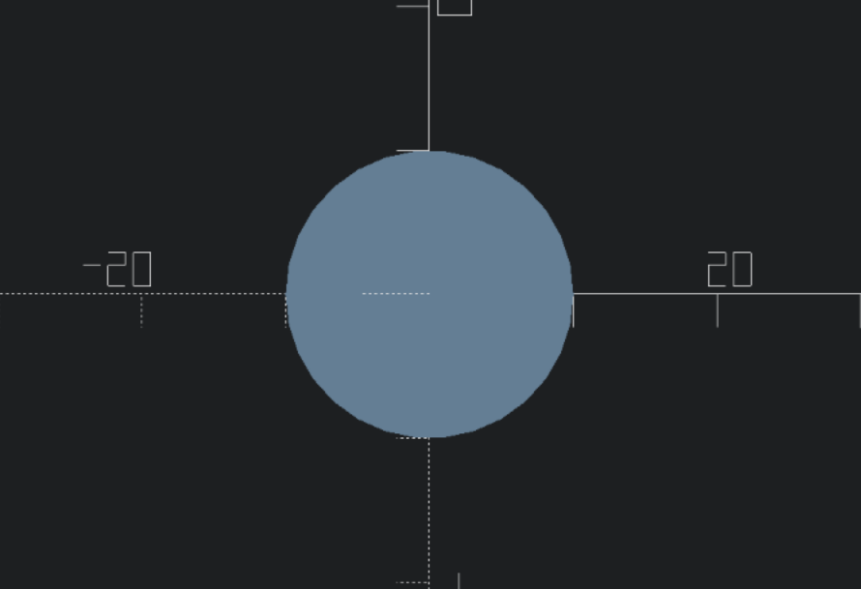
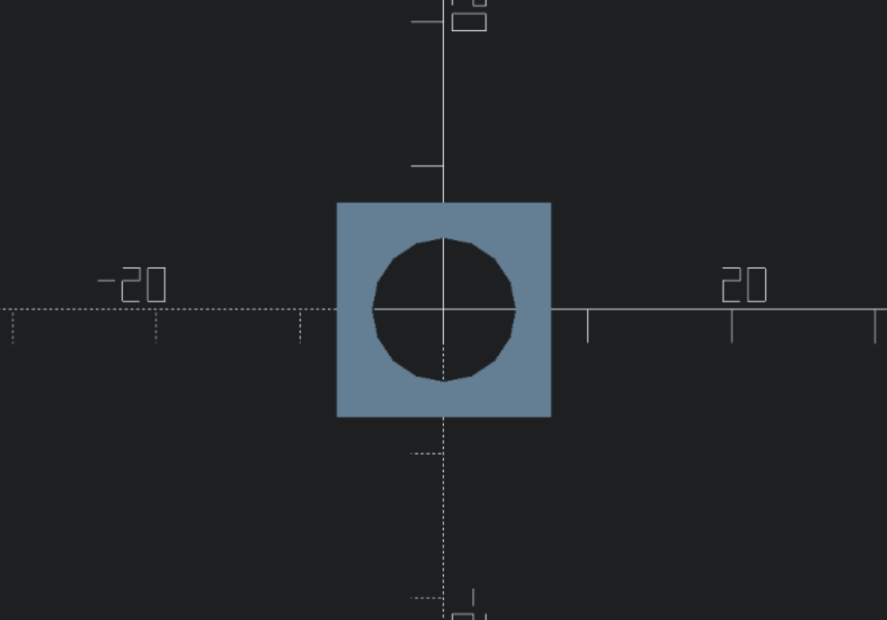
OpenSCAD syntax
Examples
circle(10);
difference() {
square(15, center = true);
circle(5);
}

Slide 9
OpenSCAD syntax
Flow Control: Conditions
if (condition) {
…
}
foo = condition
? result_if_true
: result_if_false;
if (condition) {
…
} else {
…
}
if (condition1) {
…
} else if (condition2) {
…
} …

Slide 10
OpenSCAD syntax
Flow Control: Loops
Union loops:
for (i = [start : end]) { … }
for (i = [start : step : end]) { … }
for (i = […, …, …]) { … }
for (i = …, j = …, …) { … }
Intersection loops:
intersection_for (i = [start : end]) { … }
intersection_for (i = [start : step : end]) { … }
intersection_for (i = […, …, …]) { … }

Slide 11
OpenSCAD syntax
Functions
function name ( parameters ) = value;
For example:
function clamp(v_min, t, v_max) = max(v_min, min(t, v_max));
variable = function ( parameters ) value;
For example:
clamp = function(v_min, t, v_max) max(v_min, min(t, v_max));

Slide 12
OpenSCAD syntax
Modules
module name ( parameters ) { … }
For example:
module hexagon(radius) {
circle(radius, $fn = 6);
}
Modules can receive child geometries using module children().
For example:
module rounden(radius) {
offset(radius)
offset(-radius)
children();
}

Slide 13
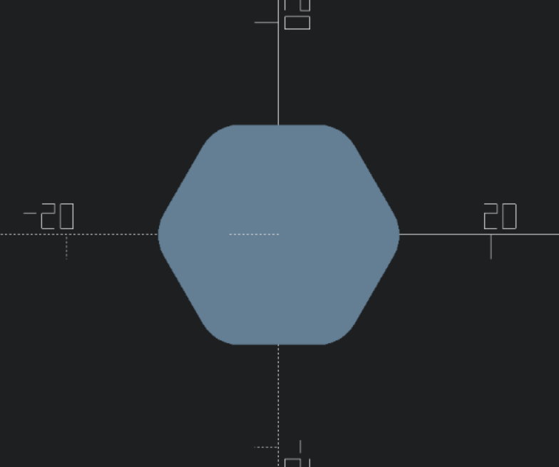
OpenSCAD syntax
Modules Example
module hexagon(radius) {
circle(radius, $fn = 6);
}
module rounden(radius) {
offset(radius)
offset(-radius)
children();
}
rounden(4, $fn = 36)
hexagon(12);

Slide 14
OpenSCAD syntax
Special functions and variables
“Only display this”
!…
“Display this for debugging”
#…
“Display this for debugging, don’t use it in further operations”
%…
How many segments to generate for approximating curves
$fn
Whether rendering in “Debug” or “Release” mode
$preview
Fully calculate the geometry of the children
render()

Slide 15
2D Shapes
circle(radius) | circle(d = diameter)
square(size, center) where
  size is number | [number, number]
  center is true | undef
polygon([points…]) | polygon([points…], [paths…])
text(t, size, font, halign, valign, …) where
  t, font are string
  size is number
  halign is “left” | “center” | “right” | undef
  valign is “top” | “center” | “baseline” | “bottom” | undef

Slide 16
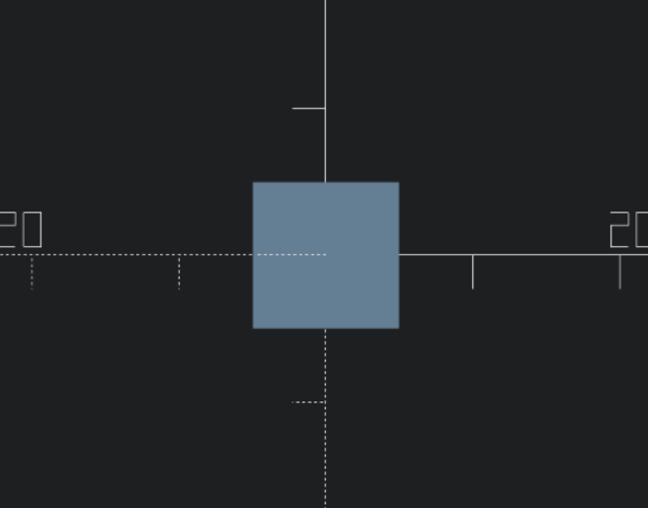
2D Shapes
All roads lead to squares
square(
10,
center = true
);
polygon([
[5, 5],
[5, -5],
[-5, -5],
[-5, 5],
]);
rotate(45)
circle(
d = 10 * sqrt(2),
$fn = 4
);

Slide 17
3D shapes
sphere(radius) | sphere(d = diameter)
cube(size, center) where
  size is number
  center is true | undef
cylinder(h, r|d, center)
cylinder(h, r1|d1, r2|d2, center)
polyhedron(points, faces)

Slide 18
Simple transformations
translate([x, y, z])
rotate(a) | rotate(a, [x, y, z])
rotate([x, y, z])
scale([x, y, z])
mirror([x, y, z])
resize([x, y, z], auto)

Slide 19
Other transformations
multmatrix(m)
offset(r | delta, chamfer)
hull()
minkowski()

Slide 20
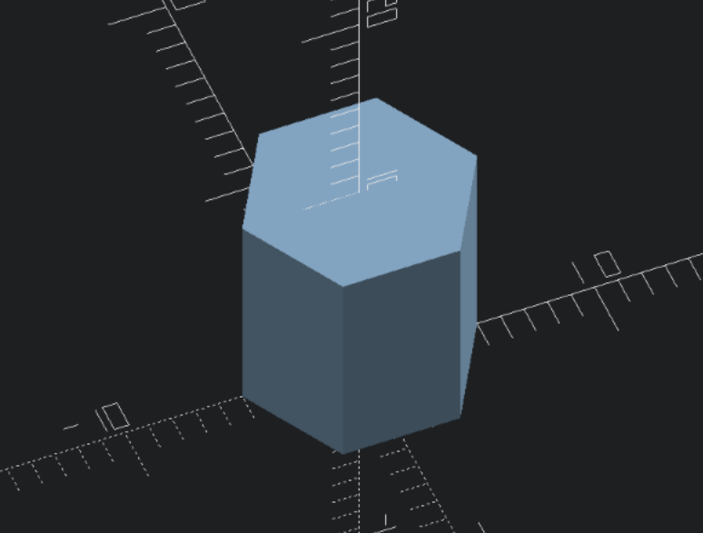
linear_extrude
linear_extrude(10)
circle(5, $fn = 6);
linear_extrude(
height,
center,
convexity,
twist,
slices
)
…

Slide 21
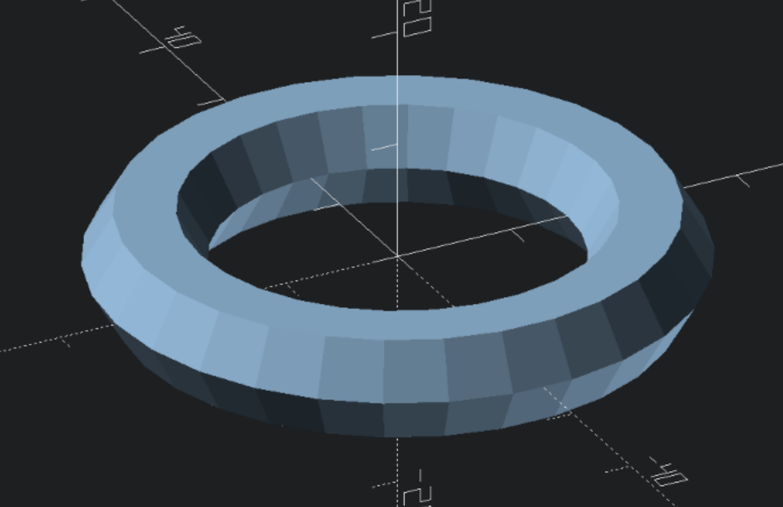
rotate_extrude
rotate_extrude(
angle,
convexity
)
…
rotate_extrude()
translate([20, 0])
circle(5, $fn = 6);

Slide 22
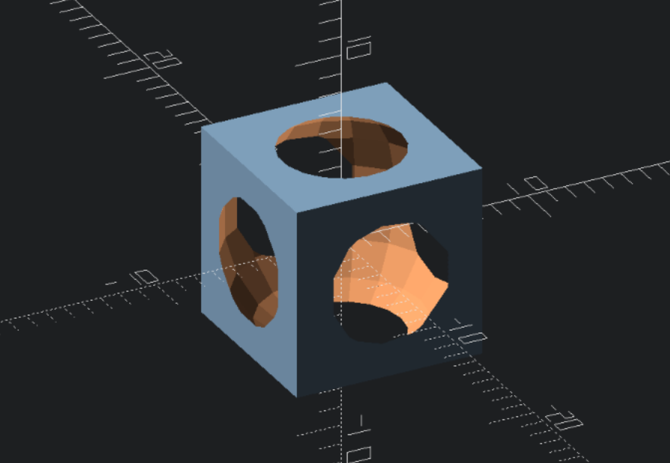
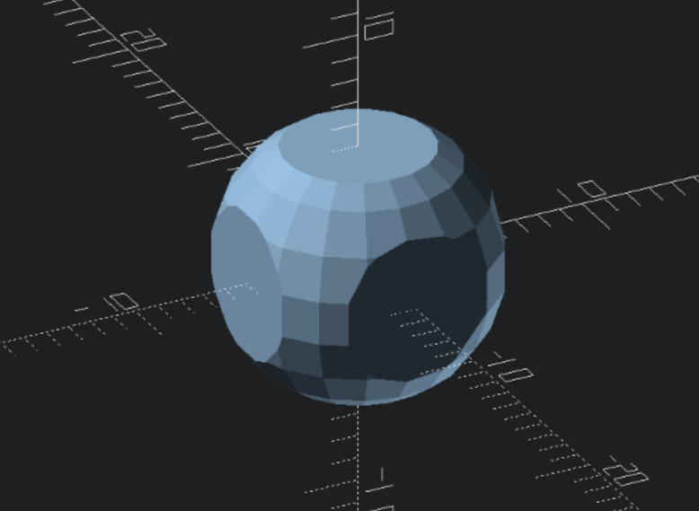
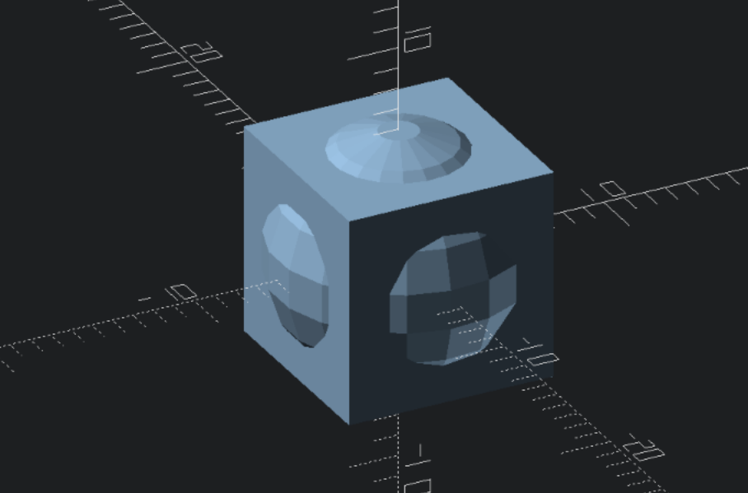
Boolean operations
difference() {
cube(10,
center = true);
sphere(6);
}
intersection() {
cube(10,
center = true);
sphere(6);
}
union() {
cube(10,
center = true);
sphere(6);
}

Slide 23
Act 2
Making complex models

Slide 24
General tips
Pay attention to your workflow
Break things down into simpler parts
Experiment and have fun
Remember some trigonometry :)

Slide 25
<Live Demo>
I am going to design a model live. You are encouraged to follow along!
Scope:
Apply what we have learned
Show how to use the OpenSCAD Customizer

Slide 26
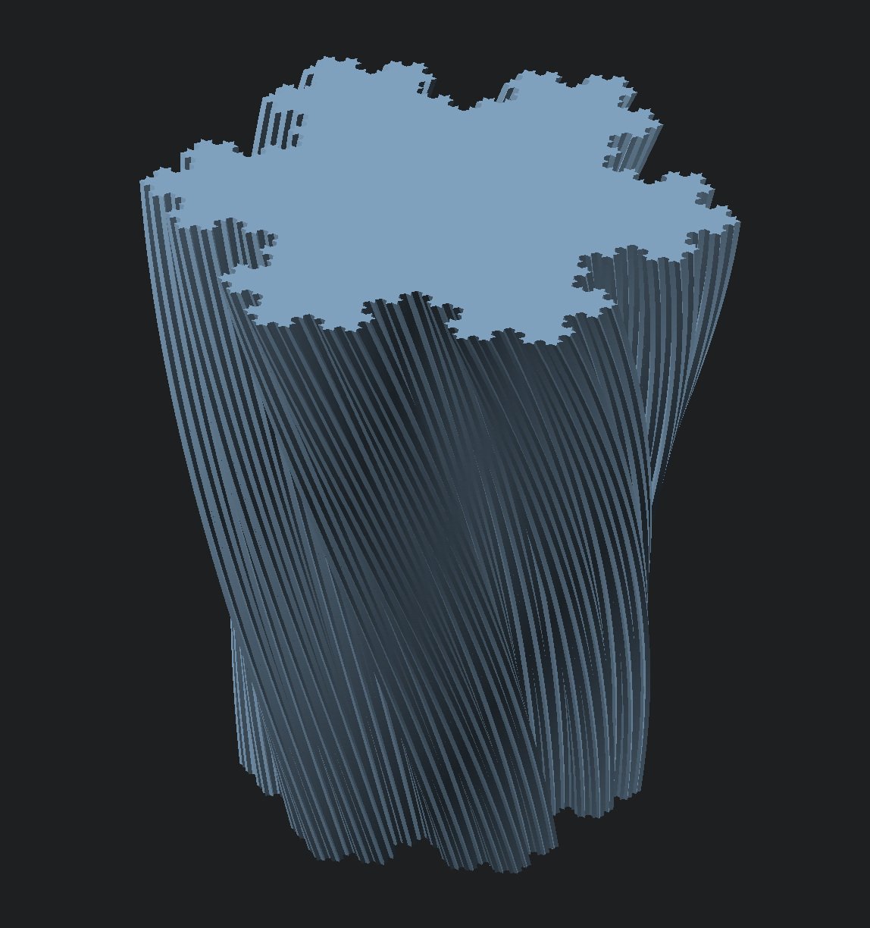
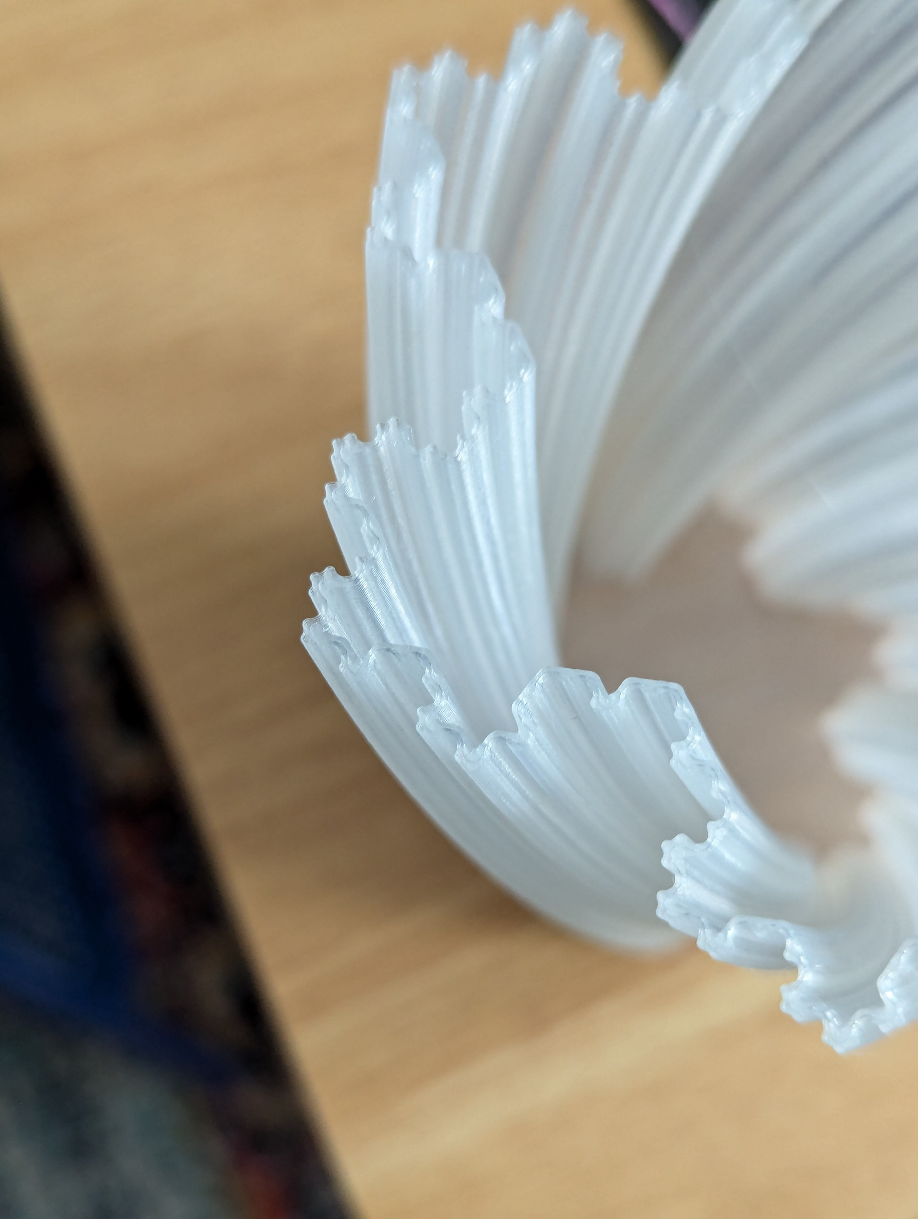
Live Model: “Koch Showflake vase”

Slide 27
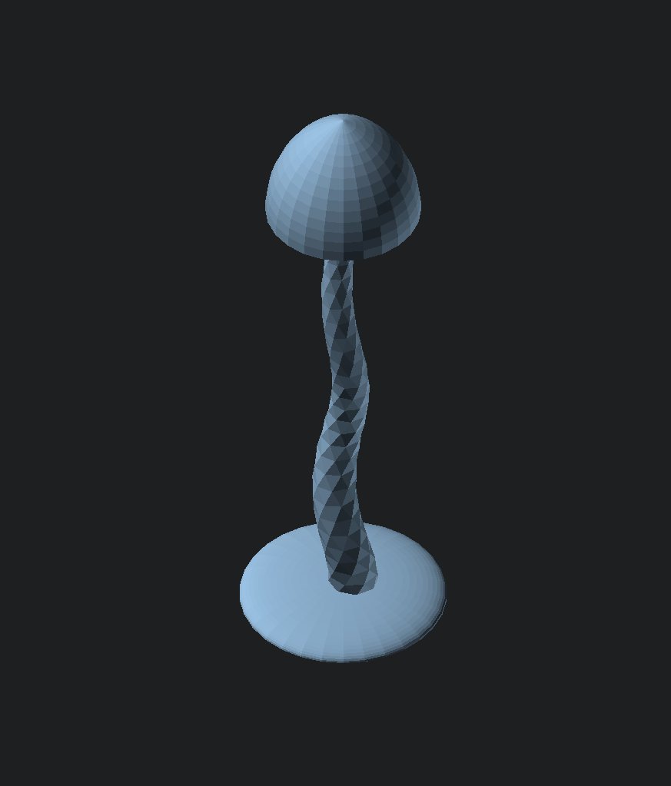
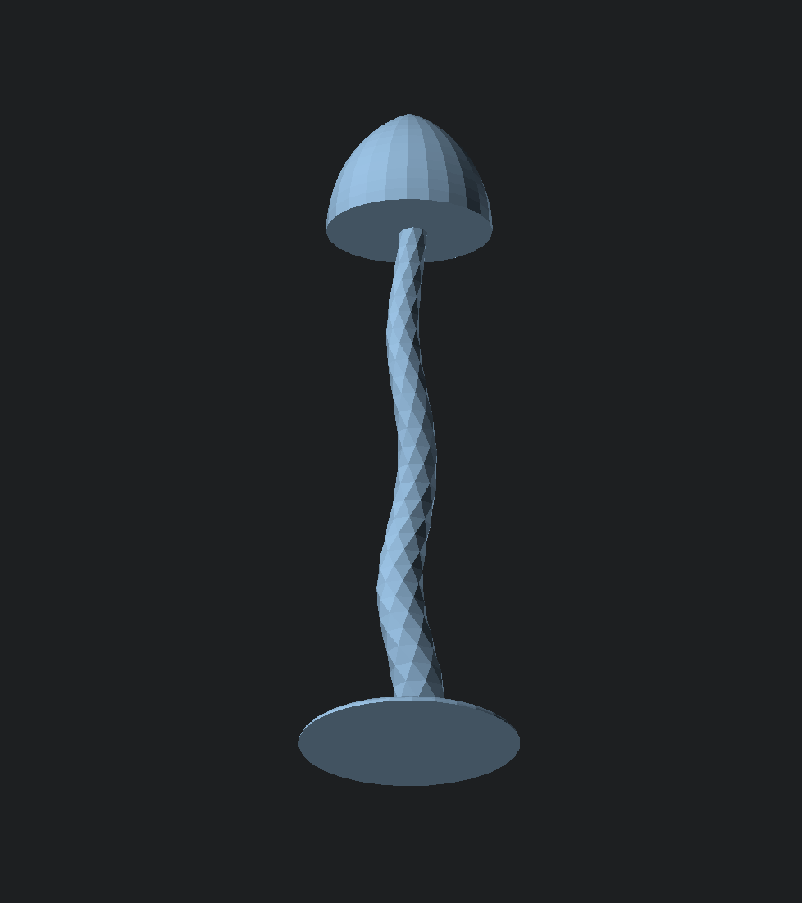
Live Model: “Mushroom”

Slide 28
Act 3
Challenges

Slide 29
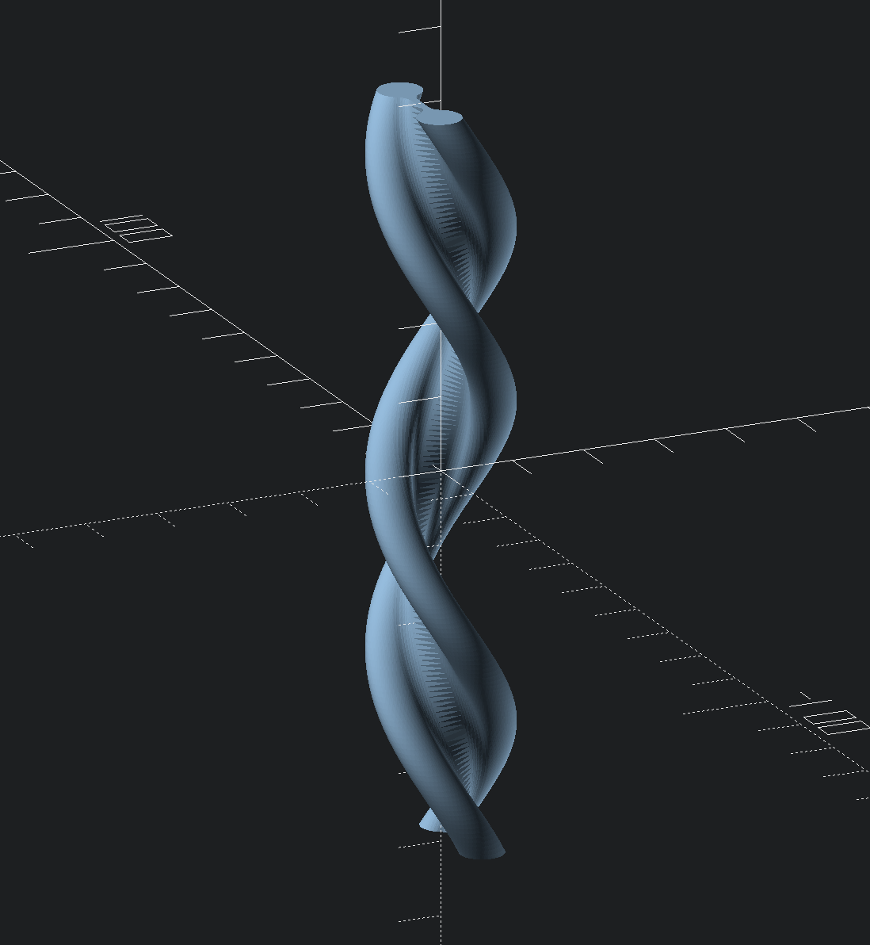
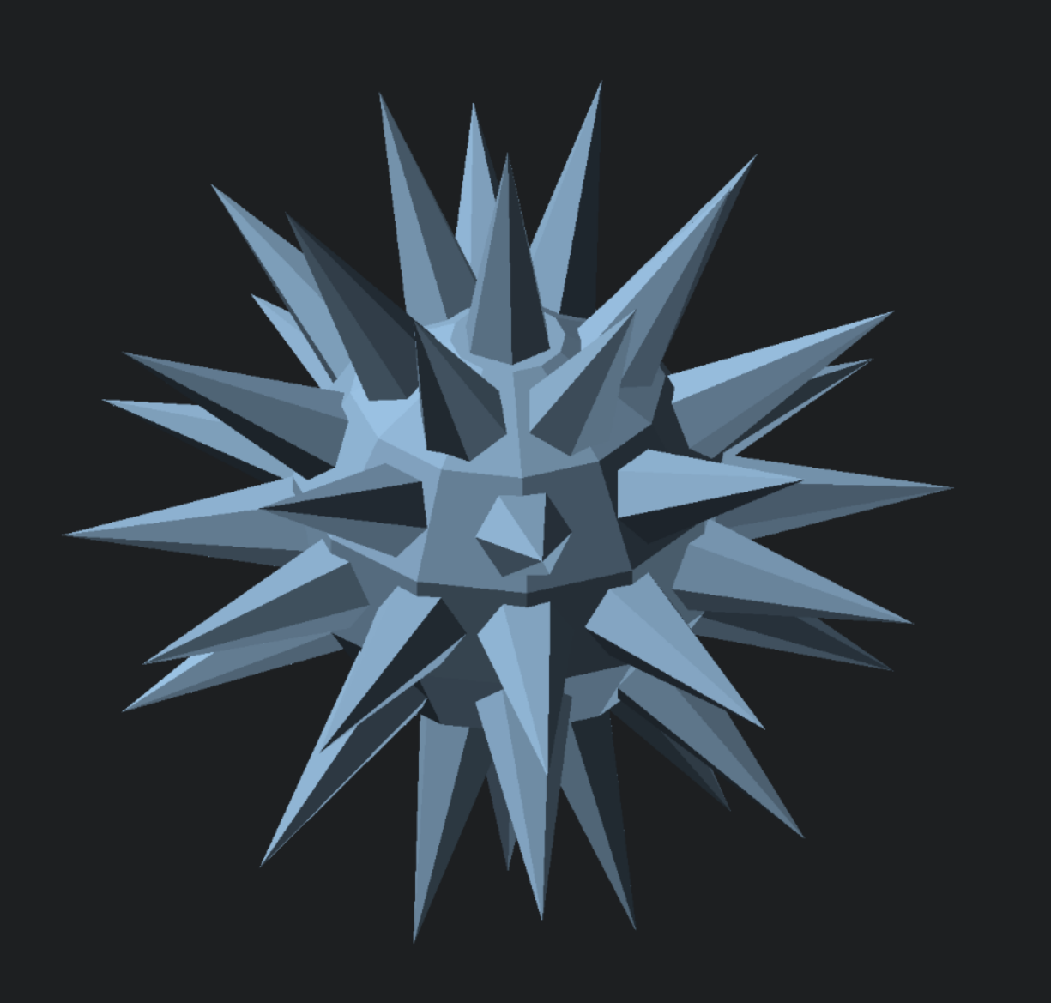
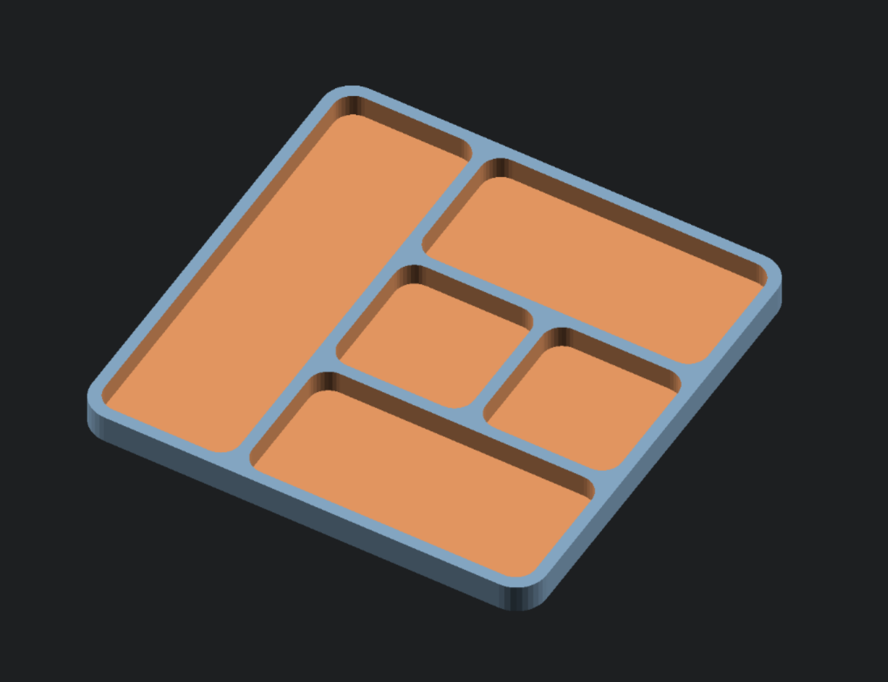
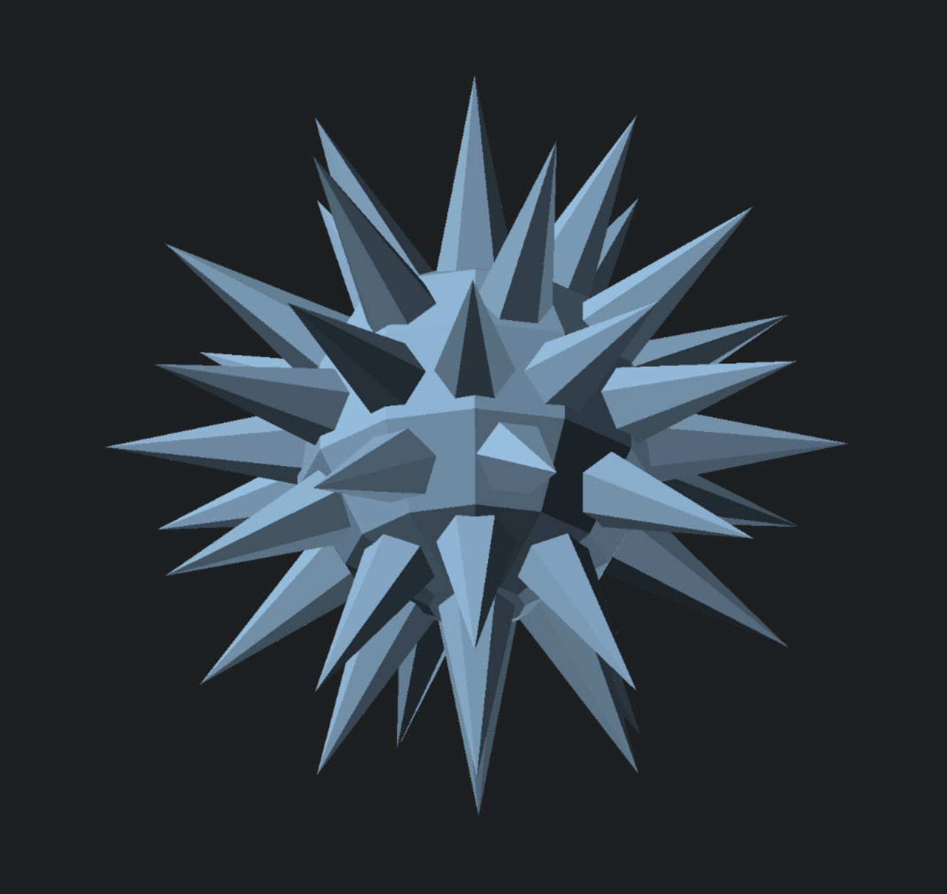
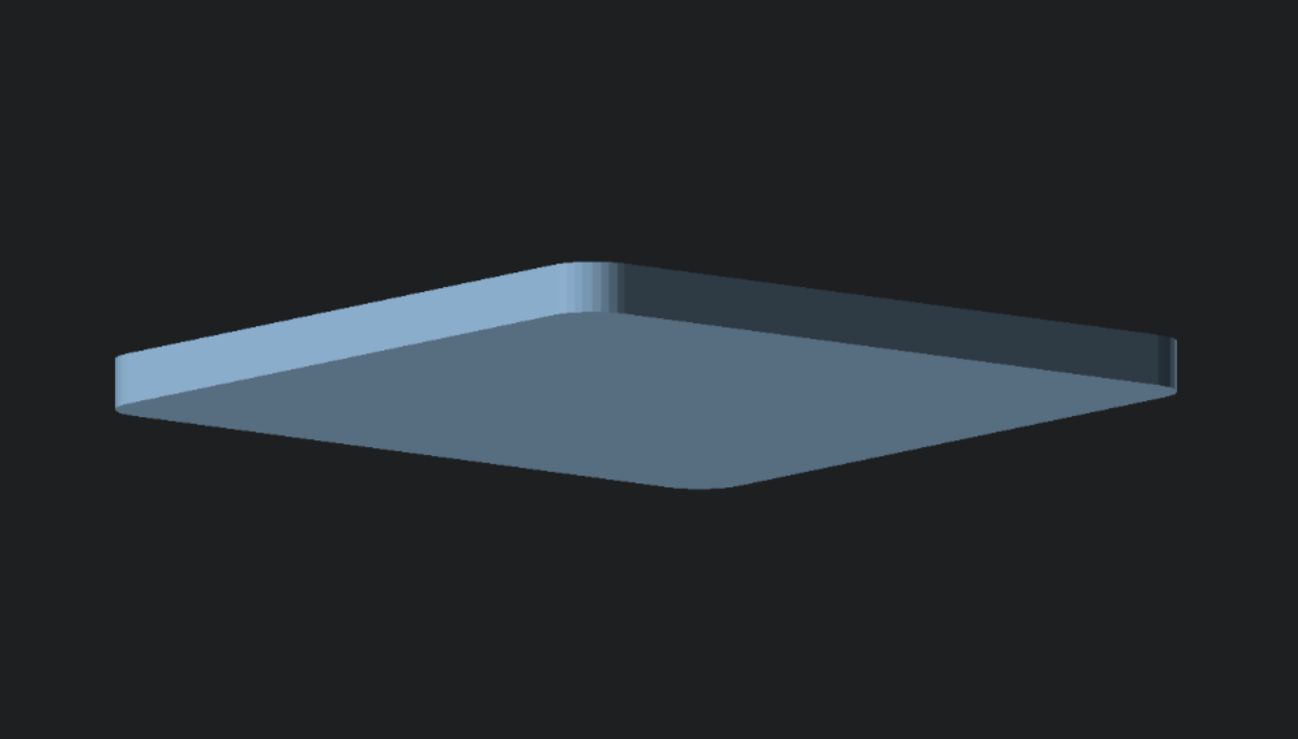
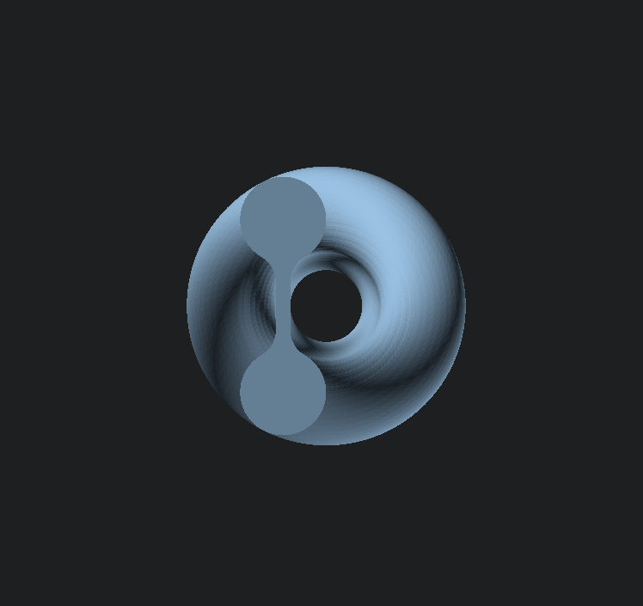
Challenges

Slide 30
The End
Thank you everybody for coming, thank you Edinburgh Hacklab for making this possible :)
--
Have a good existence,
Rei

